Slide 2
Trinity Haven is Indiana’s first transitional housing program to focus on the needs of LGBTQ young people who are experiencing
housing instability.

Slide 3
How trinity haven began
In the fall of 2017, Trinity Episcopal Church, which houses several not-for-profits on its campus, convened a task force to research the best use of an empty home on its property. In conversations with local youth-serving agencies, the task force learned that LGBTQ youth homelessness is an invisible crisis in our community.
After months of deep research and reflection, the church decided to pursue the idea of using its home as long-term transitional housing for LGBTQ youth experiencing housing instability.
In April 2018, Trinity Haven was established. Trinity Haven is not a faith-based organization, but it was created by people of faith who felt strongly they had a moral obligation to repair the damage done to LGBTQ youth in the name of religion.

Slide 4
THE NEED - NATIONALLY
National Statistics:
48% of LGBTQ youth out to their parents say that their families make them feel bad for being LGBTQ (Human Rights Campaign - HRC).
Trans youth are MORE THAN TWICE as likely to be taunted or mocked by family for their trans or non-binary identity than cisgender LGBQ youth (HRC).
75-85% of LGBTQ youth without a place to stay have been forced out by their parents or are fleeing rejection or mistreatment at home (True Colors).
LGBTQ youth and young adults are 120% more likely to experience homelessness than their heterosexual and cisgender peers (True Colors).

Slide 5
THE NEED - LOCALLY
Local Statistics:
Every night, an estimated 72 youth who identify as lesbian, gay, bisexual, transgender, or questioning (LGBTQ) are experiencing homelessness right here in our city.
68% (49/72) of these youth say that family rejection of their sexual orientation or gender identity is a major cause of their homelessness.
Many are terrified to ask for help from programs that are not specifically affirming and tailored to their needs.

Slide 6
Causes of youth homelessness
Family Conflict
Poverty
Racial Disparities
Mental Health
Substance Use Disorders
Involvement in Justice System

Slide 7
Barriers in the workplace
Openly LGBTQ applicants are less likely to get hired but being closeted negatively affects health and performance.
Workplace harassment makes environment feel unsafe, so it is difficult to find a job that will work out in long term.
Even if a job has a safe environment, LGBTQ employees are less likely to get promotions; are generally paid less than cisgender heterosexual (cishet) counterparts; and healthcare and benefits traditionally aren’t inclusive of LGBTQ needs.
All LGBTQ people are affected, but trans women of color are most hurt by these barriers.

Slide 8
Inconsistent legal protections
State law surrounding employment discrimination varies, making it hard to guarantee legal protection from discrimination.
Federal law banning discrimination does exist, but is more of a gray area and not consistently implemented as protection in states like IN.
LGBTQ workers cannot count on the law to enforce nondiscrimination.
For more details about legal protections for LGBTQ people, please visit the ACLU of Indiana (aclu-in.org) and https://www.hrc.org/resources/laws-legislation

Slide 9
closeting
Around 50% of LGBTQ people hide their identities due to feeling unwelcome or unsafe.
Being closeted negatively affects health, happiness, and productivity.
Closeted workers are 16% more likely to feel stalled in their careers and 33% more likely to make plans to leave a non-affirming job in the next year.
Hostile environments
Frequent harassment from colleagues/peers.
Double standard: expectation to talk about social life/sex in workplace or at school but viewed as oversharing when coming from LGBTQ people.
Homophobic/transphobic humor from coworkers/peers.
Believe that nothing will be done if they report homophobic/transphobic incidents.
Feeling of isolation as the “only” person of their identity, more common for trans people and queer women of color.

Slide 10
Research
3/40 Blueprint Project: Reducing LGBTQ Youth Homelessness (340blueprintproject.com)

Slide 11
Research
3/40 Blueprint Project: Reducing LGBTQ Youth Homelessness (340blueprintproject.com)

Slide 12
There is a significant difference between ‘all are welcome here’ and ‘this was created with you in mind’.
– Marcus Harrison Green
Trinity Haven was created with LGBTQ youth in mind.

Slide 13
We advance our mission of providing safe, affirming housing for LGBTQ youth experiencing housing instability and seek to partner with residents as they identify their goals; increase independent living skills; advance their education, employment and overall well-being; build a healthy network of support; and prepare for self-sufficiency and permanent housing of their choice by serving youth ages 16-24 who are LGBTQ+ (lesbian, gay, bisexual, transgender, queer, nonbinary or gender-fluid, and others) and who are experiencing housing instability.
WHAT IS TRINITY HAVEN?

Slide 14
What is Trinity Haven’s MISSION?
Trinity Haven provides safe, affirming housing for LGBTQ youth experiencing housing instability.
Notes:
Trinity Haven provides safe, affirming housing for LGBTQ youth experiencing housing instability.

Slide 15
What is Trinity Haven’s VISION?
Every LGBTQ youth in Indiana has safe, welcoming, and affirming housing within a caring community.
Notes:
Every LGBTQ youth in Indiana has safe, welcoming, and affirming housing within a caring community.

Slide 16
Transitional LIVING PROGRAM
Co-Living Space: Shared housing (with private and shared bedrooms) which creates community and fosters independence.
Not a drop-in center, an emergency shelter or a homeless shelter.
88% of youth who complete transitional living programs successfully move on into safe and independent housing.
Offers stabilization assistance, support services, independent living skills, case management, and care coordination.
Long-term housing (up to 24 months) created for LGBTQ young adults ages 16-21.

Slide 17
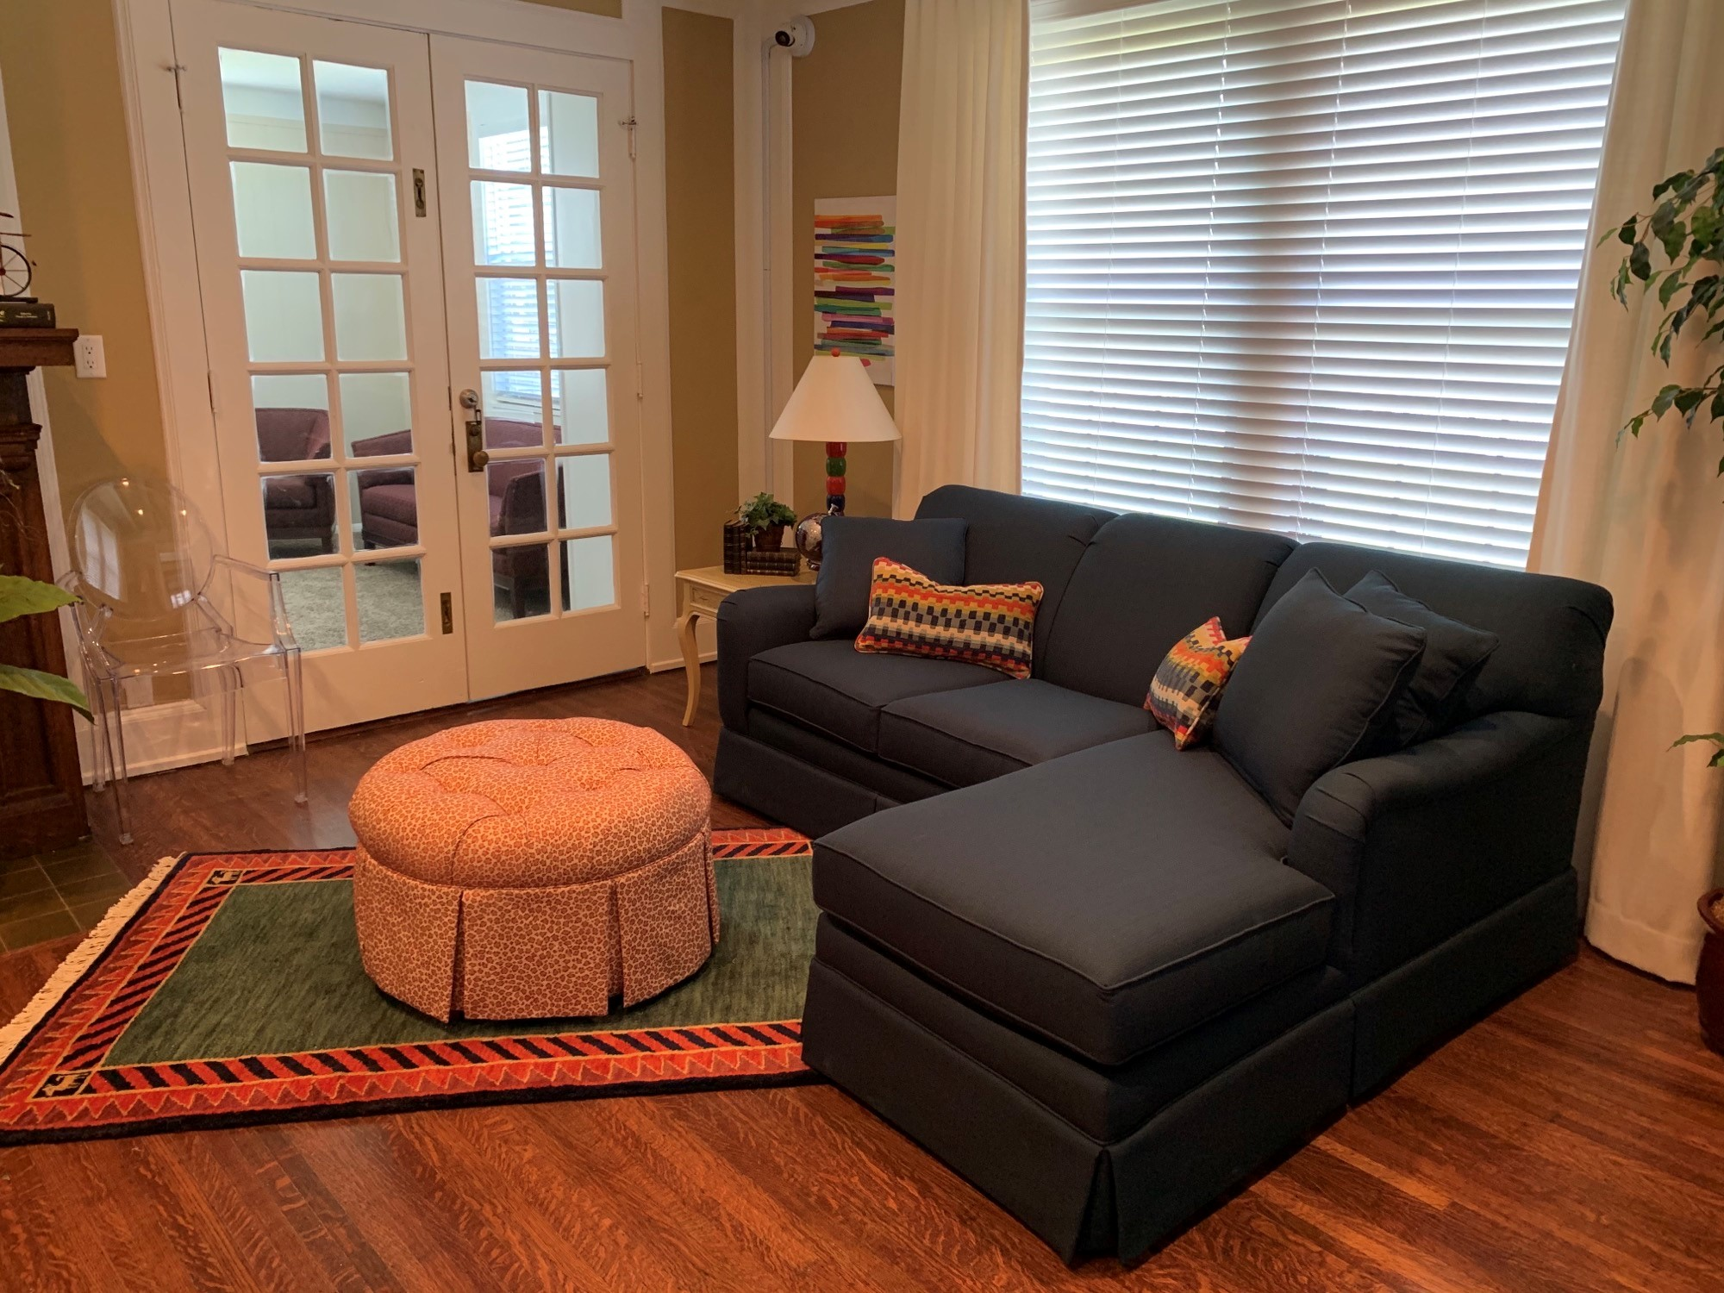
Trinity haven Family room

Slide 18
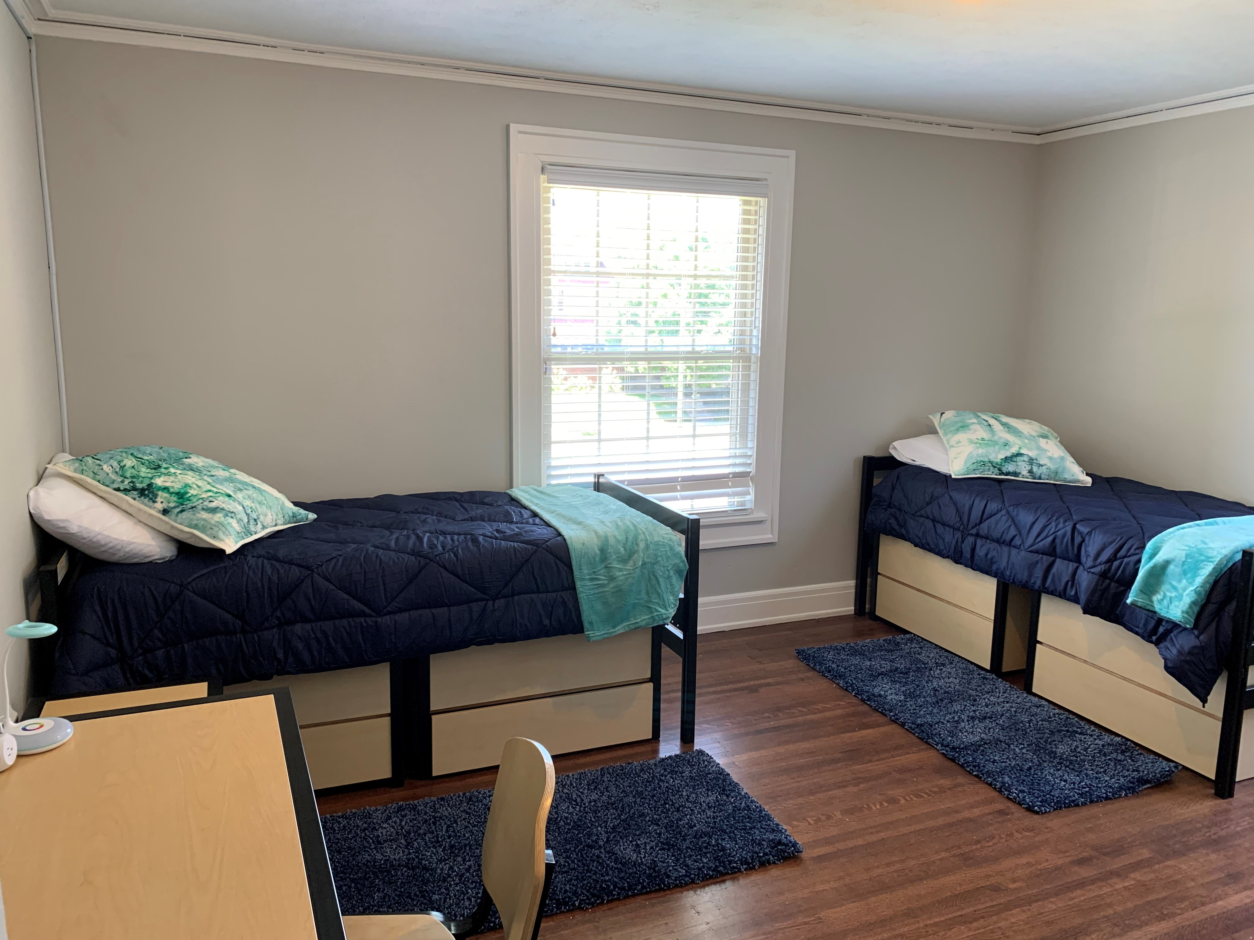
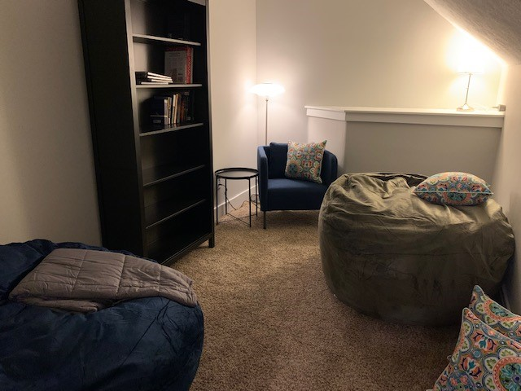
Shared bedroom & serenity room

Slide 19
A typical week at Trinity haven
Family Circle every Monday: a time for residents to connect and discuss what’s going on with them; chore schedules are assigned
Individual Meetings:
Every week, each resident meets with our Youth Engagement Specialist to check in and update progress on their Personal Plan for Independent Living, a roadmap they’ve created with goals outlined and action steps toward each goal
Every week, each resident meets with our House Director to touch base about how they are doing in our shared living program and develop goals for emotional health and wellness
Every week, each resident has a session with our Art Therapy Intern to create art, explore their feelings, and talk about how they are showing up for themselves
Living their best lives:
Residents go to school or work; attend meetings with other service providers; work on their goals; keep up with chores around the house; and have fun! Weekly visits from Paws & Think (therapy dogs!), game nights and movie nights happen regularly at Trinity Haven, too!

Slide 20
HOST HOMES PROGRAM
Host Homes provide a safe, temporary, home-like environment for LGBTQ youth who are experiencing or at-risk of entering homelessness.
Youth have a private room in the home of approved volunteer hosts while working with our Youth Engagement Specialist to repair relationships with family (however they choose to define this), focus on education or employment goals, and make decisions about housing options.
Based on the national model developed by Point Source Youth (https://www.pointsourceyouth.org/host-homes) and funded by the Youth Homelessness Demonstration Program (YHDP)/HUD.
Youth Choice / Youth Voice: LGBTQ youth choose to live with hosts, who are vetted and trained individuals and families in our community (currently limited to Indianapolis/Marion County).
Short-term housing (approx. 6 months) created for LGBTQ young adults ages 16-24.

Slide 22
Capacity
Our Transitional Living Program has a capacity of up to 9 youth/young adults.
Our Host Homes Program has a capacity of up to 10 youth/young adults.

Slide 23
REFERRALS
Department of Child Services (DCS) Older Youth Initiatives Division
Self-Referral
YouthLink – Indianapolis’ Continuum of Care

Slide 24
Youth-CENTERED VOLUNTARY SERVICES
Youth MAY attend school, vocational training OR WORK to achieve their goals.
programming and activities WILL BE PROVIDED BY TRINITY HAVEN and partner AGENCIES.
Together we will CO-CREATE COMMUNITY, ESTABLISH CONNECTIONS, and EXPLORE POSSIBILITIES.

Slide 25
GET INVOLVED
Follow us on Social Media
Sign up to receive our monthly e-newsletter
Donate your time, talent and treasure
Corporate Sponsorship of our signature event: The Homecoming Bash
Host a drive/collection – Amazon wish lists available
Volunteer: * Become a Host! * Mentor a young person! * House-related projects!
Share our Story – Raise Awareness

Slide 26
Contact Information:
Jenni White, M.S. (she/they)
Founding Executive Director
jenni@trinityhavenindy.org
Kelsey Kennedy (they/them) Host Homes Program Coordinator kelsey@trinityhavenindy.org
Trinity Haven Inc.
Indianapolis, Indiana, USA
www.trinityhavenindy.org
www.facebook.org/trinityhavenindy
@TrinityHaven

Slide 27
QUESTIONS

