Slide 1

Reality After Release
The New Citizen Program
Indiana Disproportionality Committee
August 25, 2020
Hamilton Center, Inc.

Slide 2
Objectives
Acquire knowledge about the New Citizen Program and how it is implemented in a local non-profit corporation (Hamilton Center Inc.).
Learn how participants benefitted from completion of the program.
Gain information on the advantages of incorporating a similar program within your organization.

Slide 3

History of the Program
New Citizen Program began as a vision of the CEO
Pilot program
One male, one female
Probationary employment for one year

Slide 4
History of the Program
4 departments 3 months each
“By completing your sentence you have served your debt to society”
Successful completion results in full time employment

Slide 5


My Story – Tatu Brown
Convicted Felon – how it happened
Stressors of release from incarceration
Reality after release
Outcome of New Citizen Program
TODAY
Director of Human Services,
Hamilton Center Inc.
March 11, 2004
Arrested for Dealing Cocaine

Slide 6

Committee Structure and Function
5 successful participants resulting in HCI employment
5 participants did not complete
Although some ex-offenders are looking for a career some just want a job

Slide 7

My Story – Melissa Hutchens
Convicted Felon – how it happened
Stressors of release from incarceration
Reality after release
Outcome of New Citizen Program
December 11, 2008
Arrested on two counts of conspiracy to distribute methamphetamine
TODAY
Access Specialist & Peer Recovery Specialist
Hamilton Center

Slide 8
Recidivism
“Recidivism is one of the most fundamental concepts in criminal justice. It refers to a person's relapse into criminal behavior, often after the person receives sanctions or undergoes intervention for a previous crime” (National Institute of Justice, 2019).

Slide 9
Recidivism
Recidivism is most affected by lack of employment, thus leading to homelessness.
Probability for reoffending if employed for 2 months at $10/hr is 8% compared to 37-54% if not employed.
Incarceration costs the nation $182 billion each year
(Cove and Bowes, 2015)
(National Institute of Justice, 2019)
(Equal Justice Initiative 2017)

Slide 10
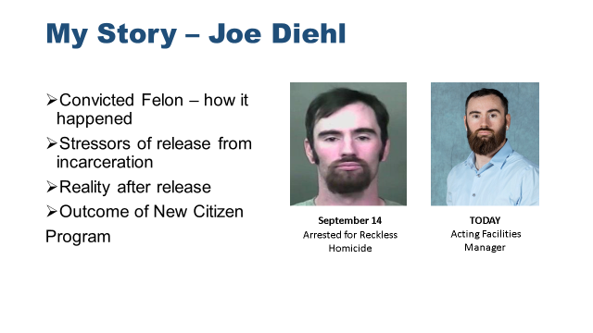
My Story – Joe Diehl
Convicted Felon – how it happened
Stressors of release from incarceration
Reality after release
Outcome of New Citizen Program

Slide 11
Success and Resources
“An ex-offender can be one of the most loyal employees…”
  According to the Department of Workforce Development….
  Employed ex-offenders are some of the most dedicated and productive employees. They are overwhelmingly dependable and punctual and turnover rate is typically low because they are loyal to those who have given them a second chance.

Slide 12
Success and Resources
Department of Workforce Development offers Work Opportunities Tax Credit
  Email: Ask.WOTC@dol.gov
Federal Bonding
  Email: FBonding@dwd.in.gov

Slide 13
Mentors = Success
Mentor committee created to wrap supports around participant
Committee consists of administrative and clinical supports
Participant is required to engage at least weekly with mentor committee

Slide 14


My Story - Stacey Totten
Convicted Felon – how it happened
Stressors of release from incarceration
Reality after release
Outcome of New Citizen
Program
December 7, 2011
Arrested for
Dealing Methamphetamines
TODAY
Manager of Recovery Services, and Peer Recovery Specialist Hamilton Center

Slide 15
Expansion
Wabash Valley Asphalt – Adopted program and on boarded first participant May 2020
Garmong Construction – Adopted program and will begin onboarding of participant November 2020

Slide 16
Closing
Change in perspective
Second Chance opportunity
Opportunity to be a tax payer not a tax burden
Helps change the perspectives of employers and other employees
Values individual’s skills and growth
(Cueller Evans & Cheema, 2012)

Slide 17
Contact Information
Tatu Brown, Director of Human Services, New Citizen Program Chair – 812-231-8107 tbrown@hamitoncenter.org
Stacey Totten, Manager of Recovery Services – 812-841-1148 stotten@hamiltoncenter.org

Slide 18
Q
&
A

Slide 19
References
Recidivism.2019. National Institute of Justice, retrieved from www.nij.ojp.gov
Cove, Peter, Bowes, Lee. 2015. Immediate Access to Employment Reduces Recidivism
Mass Incarceration Costs $182 Billion Every Year, Without Adding Much to Public Safety. 2017. Retrieved from Equal Justice Initiative. www.eji.org

